Slide 1

Blood Bank Management System
Presented By:
Richa Balupuri

Slide 2
Use Cases
Use Case 1: Donor Registration
Description: Registers new donors and saves demographic data.
Fields: - Name, Gender, DOB, Address, Phone, Blood Group, Email
Validations: - Required fields - Phone + email format
Use Case 2: Record Blood Donation
Description: Staff records donor donation.
Fields: - Donor ID - Date of Donation - Notes
Validations: - Donor must exist - Donor must be eligible
Outcome: Donation created and Inventory updated.

Slide 3
Use Cases
Use Case 3: Create Blood Unit (Automatic)
Description: Automatically triggered when a donation is recorded.
Details: - Creates blood unit with expiry and status. - Linked with donation.

Slide 4
Use Cases
Use Case 4: Hospital Blood Request
Description: Hospital requests blood units.
Fields: - Hospital ID - Blood Group - Units Required - Purpose/Patient Details
Validation: - Check availability - Avoid conflicts
Use Case 5: Allocation & Inventory Update
Description: Assign available units to requests.
Use Case 6: View Blood Inventory
Description: View available/allocated/expired units.
Filters: - Blood Group - Status

Slide 5
Architecture
Donor Registration
Action: Donor fills in registration form.
Details: - First Name, Last Name - Gender - Date of Birth - Address - Contact Number - Blood Group* - Email
Validation: - Mandatory fields must be filled. - Real-time validation for formats (phone, date, email).
Outcome: - Unique Donor ID generated. - Donor details stored in Donor Service database.
Donor Demographic Management
Action: Donor updates or verifies personal information.
Details: - Update contact details. - View donation history. - Check eligibility (auto-calculated: 90-day gap rule).
Outcome: - Updated donor profile linked to Donor ID.

Slide 6
Architecture
Blood Donation Recording
Action: Staff records a blood donation from a donor.
Details: - Enter Donor ID. - Record collected date. - Add notes if needed. - Validate donor via REST call to Donor Service.
Validation: - Donor must be eligible. - Donor must exist.
Outcome: - Donation entry created. - Donation Service sends details to Inventory Service to create a blood unit.
Blood Unit Creation in Inventory
Action: Inventory Service receives donation info.
Details: - Create a new blood unit. - Set expiry date (42 days). - Status = AVAILABLE. - Link to donor ID & donation ID.
Outcome: - Blood unit stored in inventory.

Slide 7
Architecture
Blood Request Placement (Hospital)
Action: Hospital user requests blood.
Details: - Select blood group. - Enter units needed. - Provide patient info.
Validation: - Check availability.
Outcome: - Request stored. - Units allocated from inventory. - Inventory Service updates unit status → ALLOCATED.
Unit Allocation & Delivery
Action: Blood bank staff approves and processes request.
Outcome: - Units handed over to hospital. - Status updated.

Slide 8
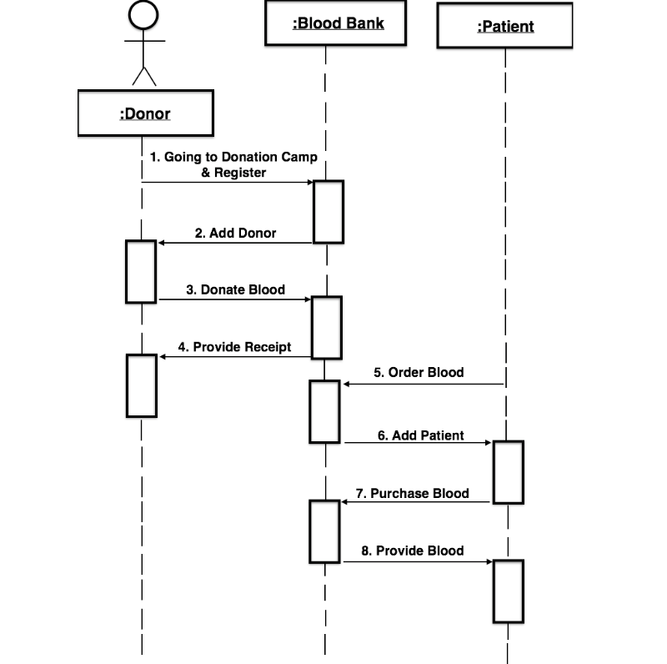
Architecture

Slide 9
Solution Approach
The people in need of blood can search for the donors by giving their blood group and city name.
It is very flexible and user friendly.
The person’s time and work is reduced very much which prevails in the present system.
Easy and Helpful.
The people are not limited to receive or provide services in working hours of the branch only; he is serviced 24 hours a day, 7 days of week and 365 days of the year.

Slide 10
Thank You

